Slide 1
Psalm 99:5
5Exalt the Lord our God and worship at his footstool; he is holy.

Slide 2
Non-Negotiables of Church Life
Acts 2: 42-47

Slide 3
Exalt, Exult, Extol Psalm 99:5

Slide 4
Exalt, Exult, Extol
Exalt the Lord our God,
And worship at His footstool—
He is holy. (NKJV)
Exalt the Lord our God!
Bow low before his feet, for he is holy! (NLT) [Psalm 99:5]

Slide 5
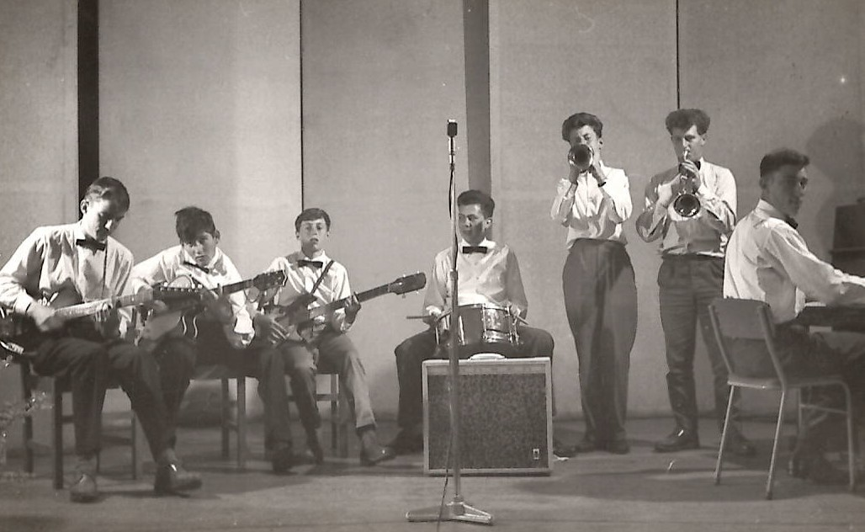
Timaru Band
1962

Slide 6
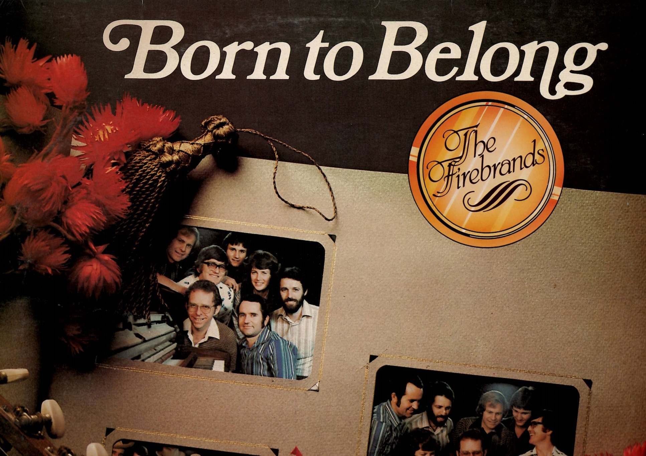
The Firebrands
Early 1980’s

Slide 7
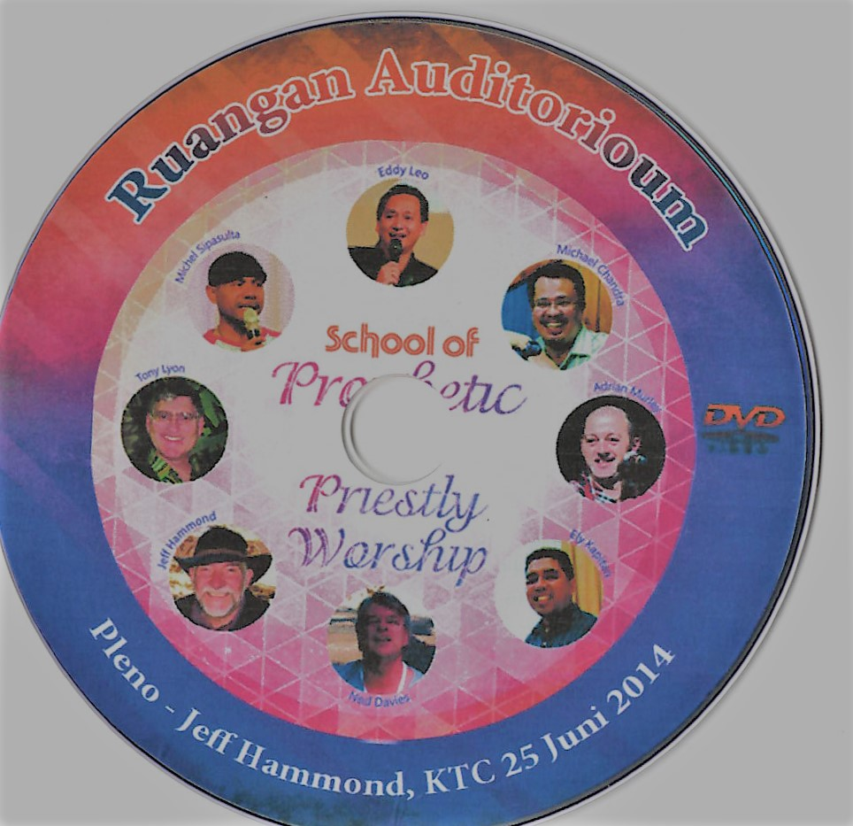
Jakarta, Indonesia
2014

Slide 8
Exalt, Exult, Extol
What does it mean to exalt God? How can we do this?
The verb “exalt” is one of those “worship words” that we hear all the time, though often without knowing what it really means.
The English word “exalt” comes from the Latin word exaltare, which means “to lift up.”

Slide 9
Exalt, Exult, Extol
But Psalm 99:5 suggests another way for us to exalt the Lord.
Notice the parallelism between the two imperatives in this verse: “Exalt the LORD our God!” parallels “Bow low before his feet.”

Slide 10
Exalt, Exult, Extol
The verb translated as “bow low” is the basic Old Testament word for worship (hishtachawa) Greek [proskyneō].
It literally means “to bow low” or “to prostrate oneself” before a sovereign.

Slide 11
Exalt, Exult, Extol
Thus, we can exalt God, figuratively speaking, not only by raising our voices to praise him, but also by lowering ourselves before him in humble worship.
Remember what the devil said to Jesus in his temptation? The offer of all the kingdoms of the world.
“I will give it all to you,” he said, “if you will kneel down and worship me.” [Matthew 4:9; cf. vs 11]

Slide 12
Exalt, Exult, Extol
All three of these words—exalt, exult, and extol—come from Latin, and all three share the same prefix, ex, which means “up” or “out”—up in these cases.
Exalt comes from the word altus meaning high, and so to exalt someone or something means to view that person or thing as up high or superior.

Slide 13
Exalt, Exult, Extol
Exult comes from salire, “to jump,” and so to exult is to jump with joy or praise.
Extol comes from tollere meaning “to raise or elevate, or to make high.”

Slide 14
Exalt, Exult, Extol
I will praise the Lord at all times.
I will constantly speak his praises.
I will boast only in the Lord;
let all who are helpless take heart.
Come, let us tell of the Lord’s greatness;
let us exalt his name together. [Psalm 34:1-3]

Slide 15
Exalt, Exult, Extol
QUESTIONS FOR REFLECTION:
How have you exalted the Lord in your life?
How could you exalt him today?

Slide 16
Exalt, Exult, Extol
Worship is an act of submission to his kingship and a proper response to his awe-inspiring presence.
It is not about you or me!
Every day they continued to meet together in the temple courts. They broke bread in their homes and ate together with glad and sincere hearts, 47 praising God and enjoying the favour of all the people. [Acts 2:46-47a].

Slide 17
Exalt, Exult, Extol
The believers praising God is an ongoing theme throughout Acts.
The Man at the Temple gate: He jumped up, stood on his feet, and began to walk! Then, walking, leaping, and praising God, he went into the Temple with them.
All the people saw him walking and heard him praising God. [Acts 3:8-9].

Slide 18
Exalt, Exult, Extol
The believers praising God as Peter and John were before the religious council; The council then threatened them further, but they finally let them go because they didn’t know how to punish them without starting a riot. For everyone was praising God for this miraculous sign—the healing of a man who had been lame for more than forty years. [Acts 4:21-22]. (Glorified)

Slide 19
Exalt, Exult, Extol
Peter explaining his actions to the Jewish believers in Jerusalem about the Holy Spirit falling on the Gentiles in Caesarea: When the others heard this, they stopped objecting and began praising God. They said, “We can see that God has also given the Gentiles the privilege of repenting of their sins and receiving eternal life.” [Acts 11:18]. (Glorified)

Slide 20
Exalt, Exult, Extol
The Gentiles when Paul announced that he would now go to the Gentiles: When the Gentiles heard this, they were very glad (Rejoicing) and thanked the Lord (Glorified) for his message; and all who were chosen for eternal life became believers. [Acts 11:18].

Slide 21
Exalt, Exult, Extol
Paul and Silas in Prison: Around midnight Paul and Silas were praying and singing hymns to God, and the other prisoners were listening. [Acts 16:25].

Slide 22
Exalt, Exult, Extol
The shepherds after seeing the child Jesus: The shepherds went back to their flocks, glorifying and praising (to praise, extol, to sing praises) God for all they had heard and seen. It was just as the angel had told them. [Luke 2:20].

Slide 23
Exalt, Exult, Extol
A unique emphasis in Luke is that when people “glorify God,” they do so by telling others about the things they have seen and heard about what God and his Son Jesus have done (Lk 2:20; 5:25–26; 7:16; 18:43; 23:47; Acts 11:18).
Mounce's Complete Expository Dictionary of Old and New Testament Words, Copyright © 2006 by William D. Mounce

Slide 24
Exalt, Exult, Extol
Luke also records the disciples worshipping: Then Jesus led them to Bethany, and lifting his hands to heaven, he blessed (eulogeō) them. While he was blessing them, (eulogeō) he left them and was taken up to heaven. So they worshiped him (proskyneō) and then returned to Jerusalem filled with great joy. And they spent all of their time in the Temple, praising God. (eulogeō )[Luke 24: 50-53].

Slide 25
Exalt, Exult, Extol
When we “bless” God and Jesus (Mt 21:9; Mk 11:9; Lk 19:38; 24:53), we are expressing our gratitude. We should note too that while God’s blessing of his creation adds substantively to them, our blessing of God adds nothing to him.
Mounce's Complete Expository Dictionary of Old and New Testament Words, Copyright © 2006 by William D. Mounce

Slide 26
Exalt, Exult, Extol
Don’t be drunk with wine, because that will ruin your life. Instead, be filled with the Holy Spirit, singing psalms and hymns and spiritual songs among yourselves, and making music to the Lord in your hearts. And give thanks for everything to God the Father in the name of our Lord Jesus Christ. [Ephesians 5:18-20]

Slide 27
Exalt, Exult, Extol
Let the message about Christ, in all its richness, fill your lives. Teach and counsel each other with all the wisdom he gives. Sing psalms and hymns and spiritual songs to God with thankful hearts. [Colossians 3:16]

